Slide 2
LESSON 4.9
Modeling with Polynomial Functions

Slide 3
Today you will:
Learn how to deal with “messy” data … more “real-world” type problems
Write polynomial functions for sets of points
Write polynomial functions using finite differences
Use technology to find models (equations) for data sets
Practice using English to describe math processes and equations

Slide 4
Core Vocabulary:
Finite differences, p 220
Prior:
First differences
Second differences
Scatter plot

Slide 5
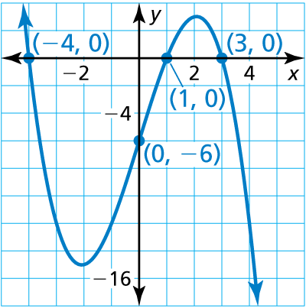
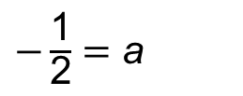

Write the cubic function whose graph is shown.
SOLUTION
Step 1 Use the three x-intercepts to write the
function in factored form.
f(x) $=$ a(x $+$ 4)(x $−$ 1)(x $−$ 3)
Step 2 Find the value of a by substituting the
coordinates of the point (0, $−$6).
Check
$−$6 $=$ a(0 $+$ 4)(0 $−$ 1)(0 $−$ 3)
Check the end behavior of f.
The degree of f is odd and
a $<$ 0. So, f(x) $→$ $+∞$ as
x $→$ $−∞$ and f(x) $→$ $−∞$ as
x $→$ $+∞$, which matches
the graph.
$−$6 $=$ 12a
$−\frac{\text{1}}{\text{2}}$ $=$ a
✓
The function is f(x) $=$ $−\frac{\text{1}}{\text{2}}$(x $+$ 4)(x $−$ 1)(x $−$ 3).

Slide 6
You do it…write a cubic function whose graph passes through the points (-1, 0), (0, -12), (2, 0), (3, 0)
Answer: $f\left(x\right)=−2(x+1)(x−2)(x−3)$

Slide 7
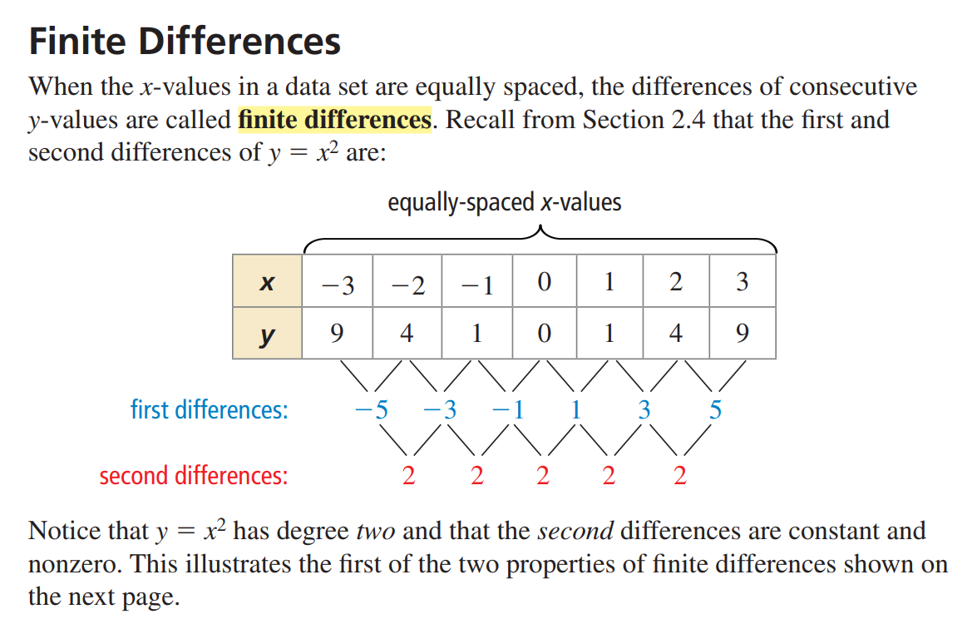

Slide 9
Use finite differences to
determine the degree of the
polynomial function that fits
the data. Then use technology
to find the polynomial function.
x | 1 | 2 | 3 | 4 | 5 | 6 | 7
f(x) | 1 | $$\text{4}$$ | 10 | 20 | 35 | 56 | 84
SOLUTION
Step 1 Find the first differences by subtracting consecutive values.
Then find the second differences by subtracting consecutive first differences.
Continue until you obtain differences that are nonzero and constant.
f(1) f(2) f(3) f(4) f(5) f(6) f(7)
Write function values for
equally-spaced x-values.
1 4 10 20 35 56 84
First differences
3 6 10 15 21 28
3 4 5 6 7
Second differences
1 1 1 1
Third differences
Because the third differences are nonzero and constant, you can model the
data exactly with a cubic function.

Slide 10
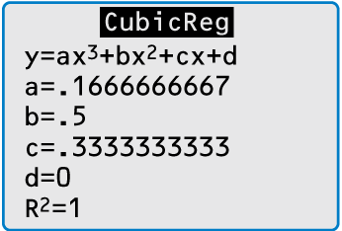
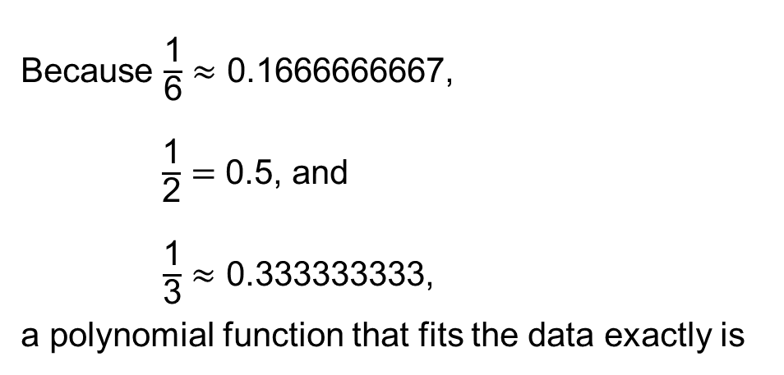
Because the third differences are nonzero and constant, you can model the
data exactly with a cubic function.
Step 2 Enter the data into a graphing calculator and use
cubic regression to obtain a polynomial function.
Because $\frac{\text{1}}{\text{6}}$ $≈$ 0.1666666667,
$\frac{\text{1}}{\text{2}}$ $=$ 0.5, and
$\frac{\text{1}}{\text{3}}$ $≈$ 0.333333333,
a polynomial function that fits the data exactly is
f(x) $=$ $\frac{\text{1}}{\text{6}}$x³ $+$ $\frac{\text{1}}{\text{2}}$x² $+$ $\frac{\text{1}}{\text{3}}$x.

Slide 11
In our prior examples we found a cubic model that exactly fit the data.
In many real-life situations, you cannot find models (equations) that fit the data exactly.
In these situations, we will find lines (or equations) of best fit using “regression” techniques.
In university you will learn how to actually perform regressions, but for now we will let our calculators do the work for us. ☺

Slide 12
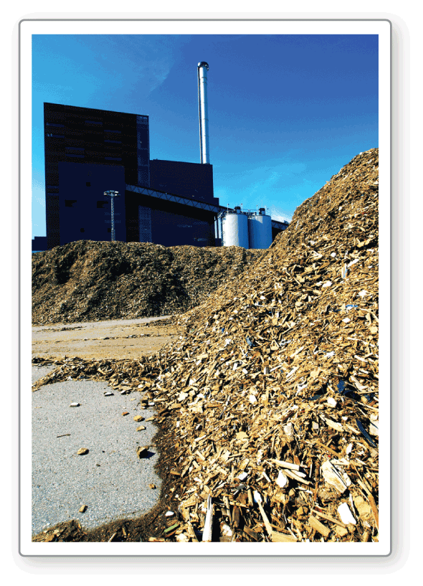
The table shows the total U.S. biomass energy consumptions y (in trillions of
British thermal units, or Btus) in the year t, where t = 1 corresponds to 2001. Find a polynomial model for the data. Use the model to estimate the total U.S. biomass energy consumption in 2013.
t | 1 | 2 | 3 | 4 | 5 | 6
y | 2622 | 2701 | 2807 | 3010 | 3117 | 3267
t | 7 | 8 | 9 | 10 | 11 | 12
y | 3493 | 3866 | 3951 | 4286 | 4421 | 4316
According to the U.S. Department of Energy, biomass includes “agricultural and forestry residues, municipal solid wastes, industrial wastes, and terrestrial and aquatic crops grown solely for energy purposes.” Among the uses for biomass is production of electricity and liquid fuels such as ethanol.
SOLUTION
Step 1 Enter the data into a graphing
calculator and make a scatter
plot. The data suggest a
cubic model.

Slide 13
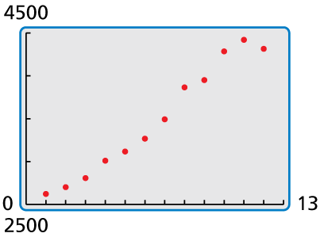
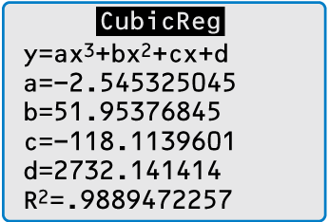
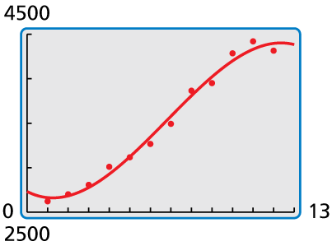
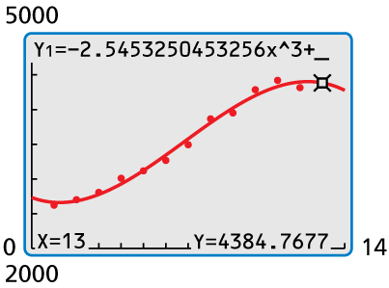
Step 1 Enter the data into a graphing
calculator and make a scatter
plot. The data suggest a
cubic model.
Step 2 Use the cubic regression feature.
The polynomial model is
If you don’t know how to use your calculator to do something (like make a scatter plot), google it!
y $=$ $−$2.545t³ $+$ 51.95t² $−$ 118.1t $+$ 2732.
For step 1:
Enter x values into list 1
Enter y values into list 2
Make a scatter plot of that data
Step 3 Check the model by graphing
it and the data in the same
viewing window.
Step 4 Use the trace feature to
estimate the value of the
model when t $=$ 13.
X: 1-12
Y: 2622, 2701, 2807, 3010,
3117, 3267, 3493, 3866,
3951, 4286, 4421, 4316
The approximate total U.S. biomass energy consumption in 2013 was about
4385 trillion Btus.

Slide 14
Homework
Pg 223, #3-11 odd, 16-18

